Slide 1
Storage Systems
Notes:
Relative to book, I included more material on the physics of the disk head
Mentioned that disk and flash device has a CPU in it – it needs it for the complex reasoning it needs to make; e.g., disk head scheduling is now done by the disk device itself, as is remapping. Disks in very olden times very smart – because the CPU was insanely expensive. When CPU’s were moderately expensive, then I/O devices became dumb – so that you could build a cheaper overall system, the file system had to do more work. Now, the CPU is very cheap, so can include more intelligence on the device.
Or even, have a network appliance that appears like a disk, but is actually a CPU, a set of disks, and a bunch of clever algorithms.
Worth including material on error correcting codes here, I think
And we should update to a newer disk example
Also, the algebra for the 80% power point needed a bit more explanation (why multiply on the left hand side)

Slide 2
Ch11: links
$ ls -al
total 84
drwxr-xr-x+ 1 bullmer CAMPUS+Group(513) 0 Oct 29 00:07 .
drwxrwxrwt+ 1 bullmer CAMPUS+Group(513) 0 Oct 21 2017 ..
-rw------- 1 bullmer CAMPUS+Group(513) 6714 May 25 14:38 .bash_history
-rwxr-xr-x 1 bullmer CAMPUS+Group(513) 1494 Jul 26 2017 .bash_profile
-rwxr-xr-x 1 bullmer CAMPUS+Group(513) 6054 Jul 26 2017 .bashrc
-rwxr-xr-x 1 bullmer CAMPUS+Group(513) 1236 Jul 26 2017 .profile
drwx------+ 1 bullmer CAMPUS+Group(513) 0 Oct 18 2018 .ssh
drwxr-xr-x+ 1 bullmer CAMPUS+Group(513) 0 Jul 27 2017 .subversion
drwxr-xr-x+ 1 bullmer CAMPUS+Group(513) 0 Dec 26 2018 bin
lrwxrwxrwx 1 bullmer CAMPUS+Group(513) 34 Apr 23 2018 book -> svnt/books/acm-tei.1/overleaf/git/
lrwxrwxrwx 1 bullmer CAMPUS+Group(513) 11 Jul 26 2017 c -> /cygdrive/c
lrwxrwxrwx 1 bullmer CAMPUS+Group(513) 5 Jul 26 2017 csvn -> c/svn
lrwxrwxrwx 1 bullmer CAMPUS+Group(513) 5 Dec 28 2017 ctmp -> c/tmp
lrwxrwxrwx 1 bullmer CAMPUS+Group(513) 15 Aug 10 2017 cu -> c/Users/bullmer
lrwxrwxrwx 1 bullmer CAMPUS+Group(513) 12 Aug 10 2017 cud -> cu/Downloads
lrwxrwxrwx 1 bullmer CAMPUS+Group(513) 11 May 27 2019 d -> /cygdrive/d
lrwxrwxrwx 1 bullmer CAMPUS+Group(513) 21 Nov 8 2019 dd -> /cygdrive/d/downloads
lrwxrwxrwx 1 bullmer CAMPUS+Group(513) 15 Jul 27 2017 dsvn -> /cygdrive/d/svn
lrwxrwxrwx 1 bullmer CAMPUS+Group(513) 26 Sep 4 2017 g17 -> svnt/grants/proposals/2017
lrwxrwxrwx 1 bullmer CAMPUS+Group(513) 26 Jun 20 2018 g18 -> svnt/grants/proposals/2018
lrwxrwxrwx 1 bullmer CAMPUS+Group(513) 26 Dec 25 2018 g19 -> svnt/grants/proposals/2019
lrwxrwxrwx 1 bullmer CAMPUS+Group(513) 26 Nov 15 2019 g20 -> svnt/grants/proposals/2020
drwxr-xr-x+ 1 bullmer CAMPUS+Group(513) 0 Jan 2 2020 git
lrwxrwxrwx 1 bullmer CAMPUS+Group(513) 19 Sep 1 2017 lp -> svnt/library/papers
lrwxrwxrwx 1 bullmer CAMPUS+Group(513) 7 Sep 5 2017 lp10 -> lp/2010
lrwxrwxrwx 1 bullmer CAMPUS+Group(513) 7 Oct 1 2017 lp90 -> lp/1990
lrwxrwxrwx 1 bullmer CAMPUS+Group(513) 16 Feb 12 2018 p18 -> svnt/papers/2018
lrwxrwxrwx 1 bullmer CAMPUS+Group(513) 12 Sep 1 2017 svnt -> csvn/tangviz du –hs ~/.subversion: 43k
du –hs ~/svnt/.svn: 53G

Slide 3
hard links
https://unix.stackexchange.com/questions/20670/why-do-hard-links-exist
compared to soft links, there is no size or speed penalty.
Soft links are an extra layer of indirection on top of normal file access;
kernel has to dereference the link when file opened; takes a small amount of time.
link also takes a small amount of space on the disk, to hold the text of the link.
to create file-based locks
the link(2) system call is atomic, unlike most other system calls
incremental backups combined with rsync; … saves lot of space
…

Slide 4
volumes
(base) [01:42:07] bullmer@melete06:~ [1] df -h
Filesystem Size Used Avail Use% Mounted on
udev 126G 0 126G 0% /dev
tmpfs 26G 1.2G 24G 5% /run
/dev/sdb1 229G 65G 152G 30% /
tmpfs 126G 8.6G 118G 7% /dev/shm
tmpfs 5.0M 0 5.0M 0% /run/lock
tmpfs 126G 0 126G 0% /sys/fs/cgroup
192.168.10.1:/volume2/melete 4.9T 867G 4.0T 18% /mnt/melete
tmpfs 26G 16K 26G 1% /run/user/124
tmpfs 26G 0 26G 0% /run/user/309856
10.20.33.2:/home/employee/bullmer 1.2T 1022G 134G 89% /home/bullmer

Slide 5
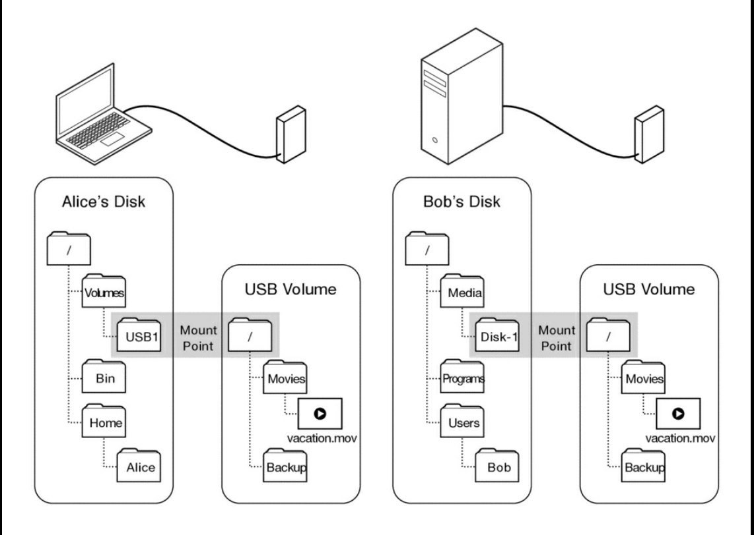

Slide 6
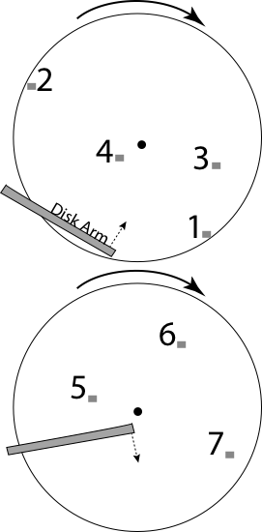
Disk Scheduling
FIFO
Schedule disk operations in order they arrive
Downsides?
1
4
2
3

Slide 7
Disk Scheduling
Shortest seek time first
Not optimal!
Suppose cluster of requests at far end of disk
Downsides?

Slide 8
Disk Scheduling
SCAN: move disk arm in one direction, until all requests satisfied, then reverse direction
Also called “elevator scheduling”

Slide 9
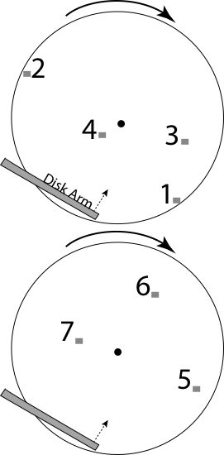
Disk Scheduling
CSCAN: move disk arm in one direction, until all requests satisfied, then start again from farthest request

Slide 10
Question
How long to complete 500 random disk reads, in any order?

Slide 11
Question
How long to complete 500 random disk reads, in any order?
Disk seek: 1ms (most will be short)
Rotation: 4.15ms
Transfer: 5-10usec
Total: 500 * (1 + 4.15 + 0.01) = 2.2 seconds
Would be a bit shorter with R-CSCAN
vs. 7.3 seconds if FIFO order

Slide 12
Question
How long to read all of the bytes off of a disk?

Slide 13
Question
How long to read all of the bytes off of a disk?
Disk capacity: 320GB
Disk bandwidth: 54-128MB/s
Transfer time =
Disk capacity / average disk bandwidth
~ 3500 seconds (1 hour)

Slide 14
File System Workload
File sizes
Are most files small or large?
Which accounts for more total storage: small or large files?

Slide 15
File System Workload
File sizes
Are most files small or large?
SMALL
Which accounts for more total storage: small or large files?
LARGE

Slide 16
File System Workload
File access
Are most accesses to small or large files?
Which accounts for more total I/O bytes: small or large files?

Slide 17
File System Workload
File access
Are most accesses to small or large files?
SMALL [book]
Which accounts for more total I/O bytes: small or large files?
LARGE [book]

Slide 18
File System Workload
How are files used?
Most files are read/written sequentially
Some files are read/written randomly
Ex: database files, swap files
Some files have a pre-defined size at creation
Some files start small and grow over time
Ex: program stdout, system logs

Slide 19
File System Design
For small files:
Small blocks for storage efficiency
Concurrent ops more efficient than sequential
Files used together should be stored together
For large files:
Storage efficient (large blocks)
Contiguous allocation for sequential access
Efficient lookup for random access
May not know at file creation
Whether file will become small or large
Whether file is persistent or temporary
Whether file will be used sequentially or randomly

